Slide 1
Software Engineering and Architecture
Comments on Mandatory

Slide 2
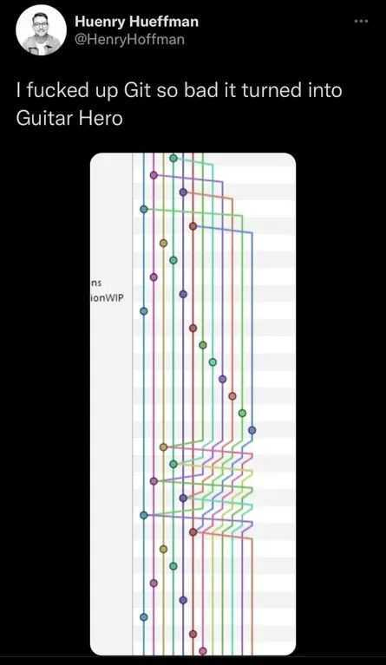
☺

Slide 3
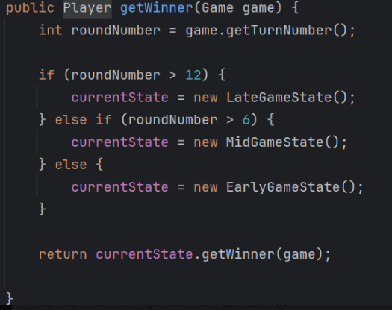
State Pattern
The point about ZetaStone was reuse ☺
Correct state pattern
… but
Each of the State’s are source-code-copy
Not reusing the WinnerStrategy but recoding it

Slide 4
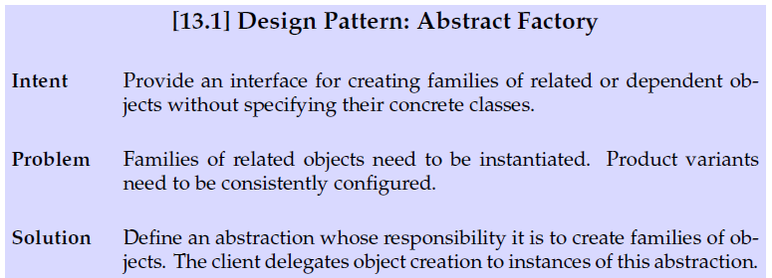
Abstract Factory
Family of objects
Consider: Game needs a Deck of cards
One feasible Strategy is to ‘List<Card> createDeck(…)’

Slide 5
Abstract Factory
Family of objects
Alpha Factory creates DeckBuildStrategy creates Deck
Alpha Factory creates Deck
Avoiding the Strategy?

Slide 6
Compositional Design
So compositional design thinking often leads to Design Patterns
And sometimes it is another one that you think
If you have HeroBuildingStrategy and DeckBuildingStrategy
(As I have)
Then they are more like a ‘Abs Factory’ than ‘Strategy’
And can probably be removed and replaced by your factory
(I have been lazy and have not done so.)

Slide 7
Test Stub
The ‘pick random minion’ is a responsibility which must be encapsulated in a role via an interface and can be played by two objects
The real random object production code
The stubbed object test code
How to configure EpsilonStone to use the proper object?
Analysis
Creating an object to generate random indices is a part of the HotStone configuration – and should be in the Abs Factory

Slide 8
Configuring Epsilon
Tedious to create a new Java file with just that one minor change compared to normal Epsilon
Class TestEpsilonFactory extends EpsilonFactory { … }
You can use ‘anonymous classes’ instead…

Slide 9
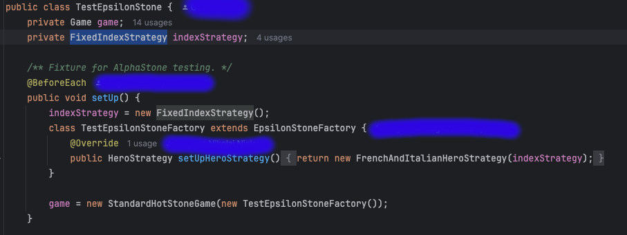
Ala…
... In place overwriting a method
Critique: Methods should be called ‘create…’ or similar

